Slide 1
A Guide to Getting Help with Your Course

Slide 2
Getting the Right Help
AUT has many people to help support your studies
Knowing who to contact will resolve your query faster
Most questions can be resolved quickly at the right level

Slide 3
Your First Point of Contact
Start with the person closest to your learning
In most cases, this is your Course Leader
If needed, your query can be progressed step-by-step

Slide 4
Roles: Who Does What?
The Course Leader manages your teaching, assessments, and course delivery.
Usually, but not always, the Course Leader is your weekly lecturer
The Major Leader supports your specialisation and academic pathway
Major Leaders reports to the Programme Director
The Programme Director oversees programme structure and quality
The Head of Department provides leadership to staff teaching across programmes

Slide 5
Who Should I Contact?
For assessment queries contact the Course Leader
For course-related concerns contact the Course Leader
For major or study pathway advice contact the Major Leader
For any unresolved queries escalate up one step:
Course Leader → Major Leader → Programme Director
The Programme Director contacts Head of Department as needed

Slide 6

Head of Department Computer & Information Sciences
A/Prof. Mahsa Mohaghegh
mahsa.mohaghegh@aut.ac.nz
Manages Programme Directors

Slide 7
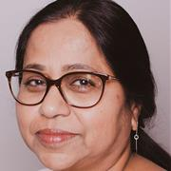
Post-Graduate Studies Programme Director
Dr. Mali Senapathi
mali.senapathi@aut.ac.nz
Programme Director PG Studies

Slide 8
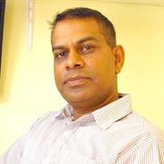
Master of Computing and Information Sciences
Parma Nand
parma.nand@aut.ac.nz
Programme Director

Slide 9
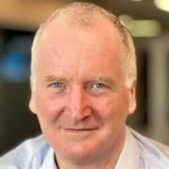
Master of Cyber Security and Digital Forensics
Dr. Alastair Nisbet
alastair.nisbet@aut.ac.nz
Programme Director

Slide 10
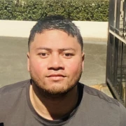
Master of IT Project Management
Daniel Vaipulu
daniel.vaipulu@aut.ac.nz
Programme Director

Slide 11
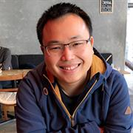
Bachelor of Computer and Information Sciences
Matthew Kuo
matthew.kuo@aut.ac.nz
BCIS Programme Director

Slide 12

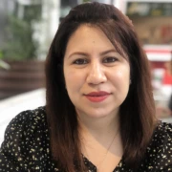
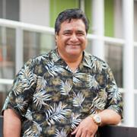
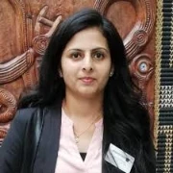
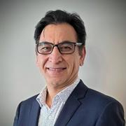
BCIS Major Leaders
Dr. Nathan Allen
Dr. Duaa Zuhair Al-Hamid
Dr. Raymond Lutui
Dr. Anuradha Singh
Dr. Akbar Ghobakhlou
Computer Science
Digital Services
Network and Cyber Security
Software Development
Data Science
nathan.allen @aut.ac.nz
duaa.alhamid @aut.ac.nz
raymond.lutui @aut.ac.nz
anuradha.singh @aut.ac.nz
akbar.ghobakhlou@aut.ac.nz

Slide 13
Further Questions?
Why not visit student reception on the third floor of the WZ building!
We can provide you advice and help you get into contact with the best person to answer your questions

